Slide 1
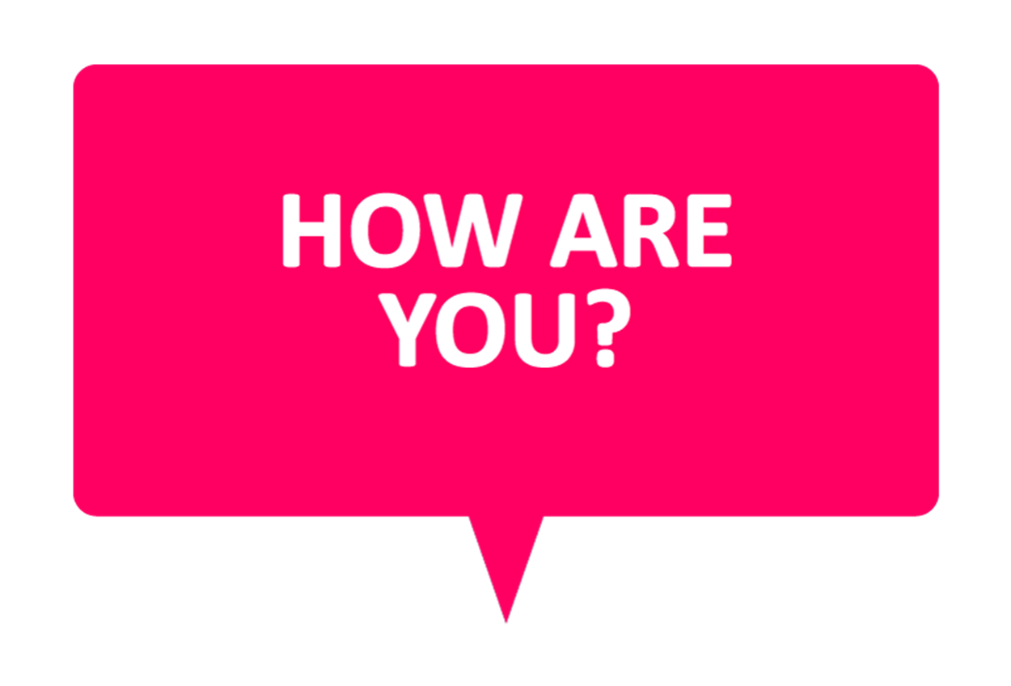
WELCOME TO ENGLISH CLASS

Slide 2


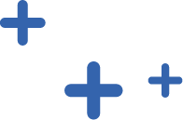
WELCOME TO ENGLISH CLASS
“One language sets you in a corridor for life. Two languages open every door along the way.”
Franck Smith.

Slide 3



Usability and Accessibility Computer Programs

Slide 4
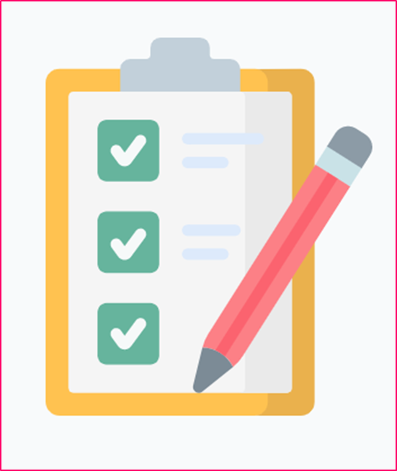
DATE
DATE
Objective:
Students will construct a word cloud using the key words from the text about Usability and Accessibility of computer programs.

Slide 5
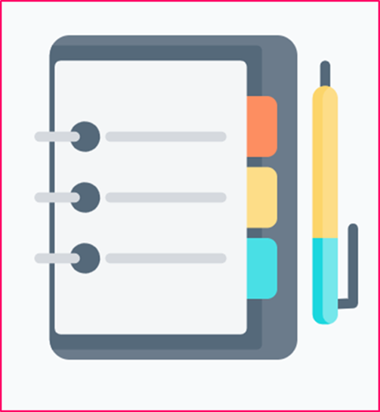
AGENDA
WARM UP:
Finish the sentence using a posible ways: “A product is accessible if ...”
CLASS ACTIVITY:
New Vocabulary
Reading Strategy: Looking for key words
Reading: Concepts of usability and accessibility in software development
Wrap- Up
Answer these True or False questions to check your understanding of the text.

Slide 6

WARM-UP
Finish the sentence using a posible ways:
“A product is accessible if ...”

Slide 7
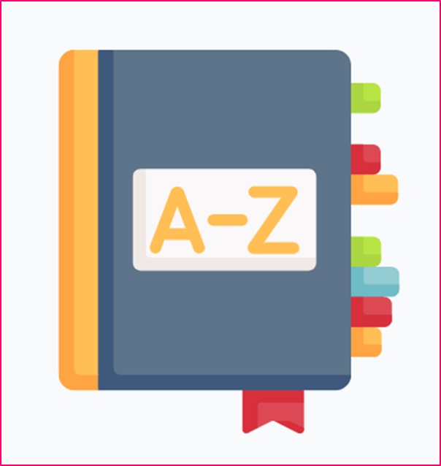
VOCABULARY
Measures medida
Disabilities incapaz
Average promedio
Inner interno
Consistency conssitente
Trust confiable
Unreliable poco confiable
Ultimate lo mas moderno, final
Nowadays hoy en dia

Slide 8
PRACTICE TIME
Complete the crossword using the meaning of the vocabulary words above.
 |  |  |  |  |  |  | 2
 | 1
 |  | 3
8 |  |  |  |  |  |  |  |  | 4 |  |  |  |  |  |  |  |  |  | 9
 |  |  |  |  |  |  |  |  |  |  |  |  |  |  | 7
 |  |  |  |  |  |  |  |  | 6 |  |  | 5

Slide 9
PRACTICE TIME
Across
1.A standard unit used to express the size, amount, or degree of something.
8 . Consistent behavior or treatment.
6. A physical or mental condition that limits a person's movements, senses, or activities.
Down
1 Believe in the reliability, truth, or ability
3 Happening or occurring inside
4 At the present time, in contrast with the past.
5 A number that is calculated by adding quantities together and dividing the total by the number of quantities
7 Being or happening at the end of a process; final.
9 Not able to be relied upon.

Slide 10

Video: Reading Strategy
Looking for key words
https://youtu.be/wMxi6mMYdqE
https://youtu.be/wMxi6mMYdqE
https://youtu.be/wMxi6mMYdqE
https://youtu.be/wMxi6mMYdqE

Slide 11
Reading Strategy Exercise
Answer the following question:
Can content words, like verbs and nouns, be key words?
Can function words, like prepositions and articles, be key words
Do you think that key words are often repeated in the text?

Slide 12
Text :Usability and Accessibility of Software
Read the text then create a word cloud using the key words you found in the text.
CONCEPTS OF USABILITY AND ACCESSIBILITY IN SOFTWARE DEVELOPMENT
UNIVERSAL DESIGN
Usability and accessibility are two important concepts in the process of software development. Usability measures how easy it is to use a program, and accessibility measures how accessible a program is for people with different disabilities. Typically, programs are designed for the average user and do not consider all the possible characteristics of potential users. Ideally, developers should consider the principles of the “universal design” when creating a new product. Universal design means that absolutely everyone can use the final product. The application of universal design principles during product design has the potential to make products accessible to and usable by more consumers.
USABILITY TESTING
Many companies do usability testing to guarantee that the product is satisfactory for the users. This usability process is frequently done at different phases of product development. The objective of the usability testing is to make the product more efficient and attractive to users. Jakob Neilsen, one of the most visible proponents of usability processes, articulated five elements that comprise a definition of usability (Nielsen, 1996).

Slide 13
Text :Usability and Accessibility of Software
Ease of use. The user must be able to use the product in a simple form.
Simplicity of learning. The features of a product must have inner consistency and logic.
Improved reliability. When users can trust that they can use products as expected, satisfaction can increase.
Reduction in errors. Designers can reduce user errors. It is important for the developers to understand that the product can be culpable or unreliable. In this case, they can re-design it in a good way.
Improved user satisfaction. If user satisfaction is important for the developers, they should incorporate all the previous recommendations in the product. As a result, users will be happy to use it.

Slide 14
Text :Usability and Accessibility of Software
ACCESSIBILITY
Accessibility refers to creating products that are accessible for different kinds of people. Accessibility tests on new products are not very common, and when companies do this type of tests, they usually do them after usability testing. As a result, many products meet only minimum accessibility standards, but this doesn´t mean that they are easy to use for all people.
For example, historically, people with disabilities are not included in the standard usability tests of many products because designers do not consider people with disabilities to be part of the ultimate users. However, nowadays the population of people with disabilities grows and it means that more and more products for them will be necessary.
Links for word clouds exercises
https://www.nubedepalabras.es/
http://www.tagxedo.com/

Slide 15
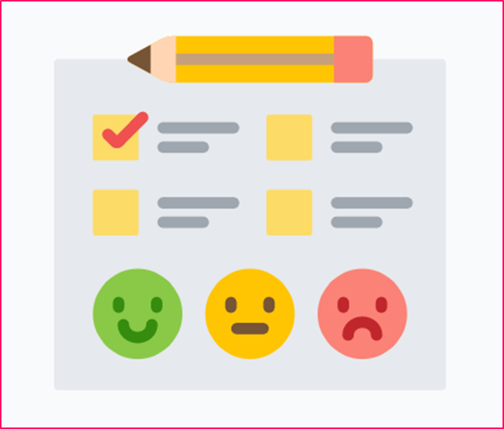
WRAP-UP
Answer these True or False questions to check your understanding of the text.
Usability and Accessibility are two synonyms that mean the same.
A universal design product is easy to use by all the people.
The objective of usability testing is to make the product more attractive for the users.
Accessibility test are very common in many companies.
Companies often do not take people with disabilities into account when designing new products.

Slide 16

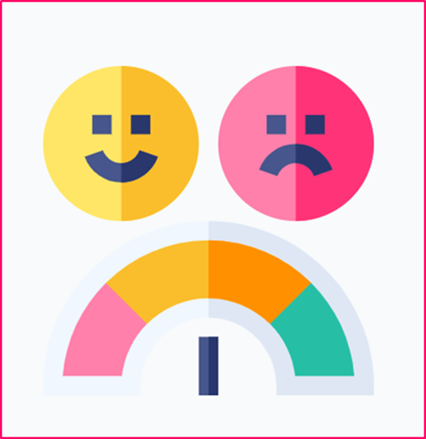
Answer the following questions.
Entiendo que es “usability” y “accessibility” y la diferencia entre ellos. Si No Tal vez
Entiendo cómo buscar las palabras claves en un texto. Si No Tal vez
Buscar las palabras claves en un texto me ayuda a identificar los conceptos principales del texto. Si No Tal vez

